Slide 1
FACE MASK DETECTION USING CNN
Dhaval B. Patel [200439819]
Vedang Pandya [200427798]

Slide 2
PROBLEM STATEMENT
There are certain air born diseases which are contagious. Moreover air pollution is on the rise in many cities around the world. So it has become paramount for regimes to take substantial steps to address this problems.
The recent upsurge of covid19 up to certain extent was because of ineffective enforcement of the preventive measures like social distancing and mandatory use of face mask.
Recently, there is no such system deployed by government for face mask detection in canada.
The application can serve as an effective solution for various use cases like
Airports
Hospitals
Offices and work spaces

Slide 3
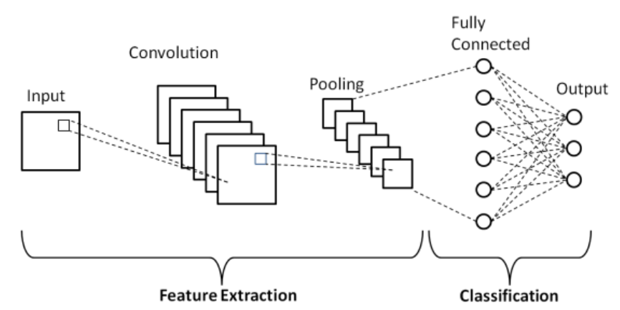
CNN
FIGURE : BLOCK DIAGRAM OF CONVOLUTIONAL NEURAL NETWORK

Slide 4
CNN
CONVOLUTIONAL NEURAL NETWORK COMPRISES FOLLOWING LAYERS
Convolutional layer
Pooling layer
Non linearity (ReLU)
Fully connected layer

Slide 5
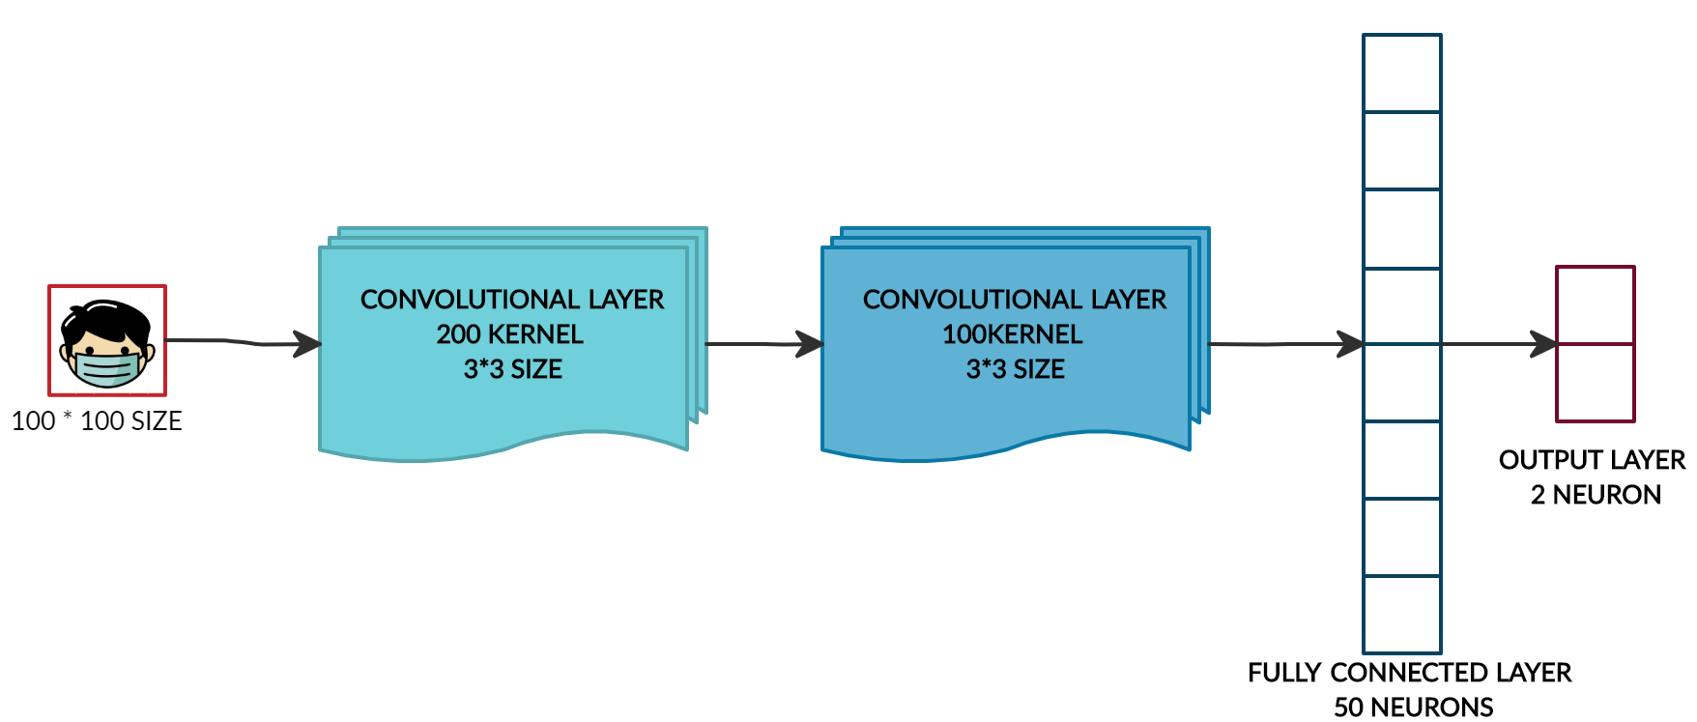
PROPOSED CNN
FIGURE : BLOCK DIAGRAM OF PROPOSED CONVOLUTIONAL NEURAL NETWORK

Slide 6
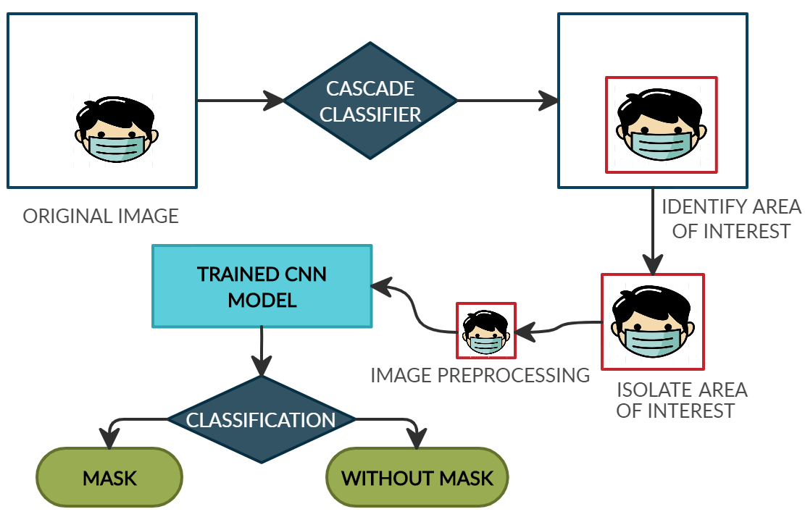
PROPOSED SOLUTION

Slide 7
ALGORITHM
Proposed algorithm for the solution is as follows:
Step 1] Train the neural network on the dataset and save the best trained CNN model.
Step 2] Take the live feed from video source and split it into images
Step 3] Apply classifier on the image to isolate area of interest [ i.e the face regions ]
Step 4] Apply pre-processing on the classified image.
Step 5] Feed the image in the best trained CNN model and identify if the face is with mask or without mask.

Slide 8
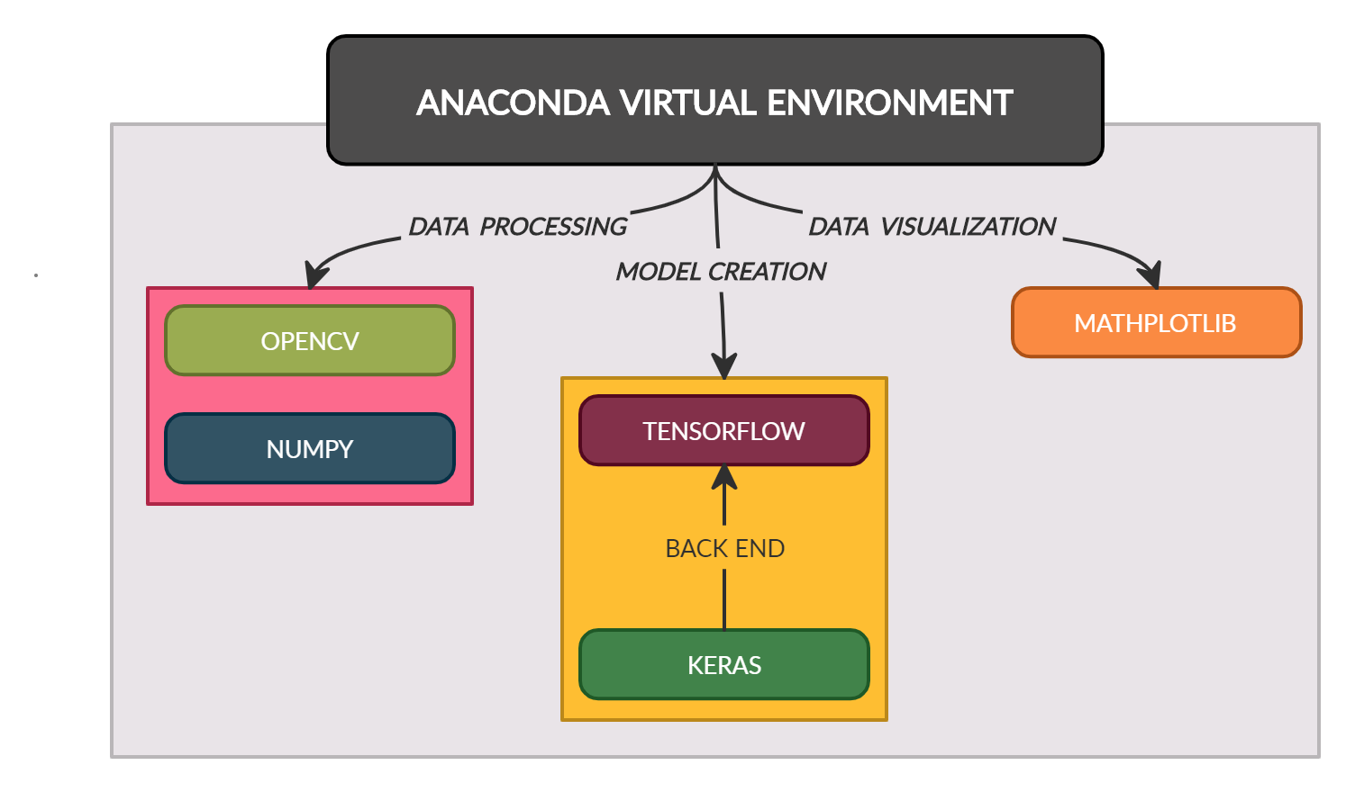





STATE OF THE ART TECHNOLOGY

Slide 9
CHALLENGES & EXPECTED OUTCOME
CHALLENGES | EXPECTED OUTCOME
The neural network cannot give instructions for the people without mask. In addition some people might keep their hands on the mouth thereby evading the face mask detection system. In such case the neural network must respond by appropriate inputs. | We need to see how this system performs in terms of its speed and reliability. The delay involved should be minimum and it should reliably detect face mask irrespective of number of people and type of masks.
It should also be able to detect the people who tend to pull their mask below their nose level in order to breathe properly. In such case it should indicate like partially covered and request the user to cover their nose. | Accuracy for the proposed model should be comparable to pre-trained model like YOLOv3 and googlenet.
How the system is going to be deployed on web and data analytics on the images like percentage of people with mask and without mask | Identify the Faces with mask and without mask in the same frame in the live video feed

Slide 10
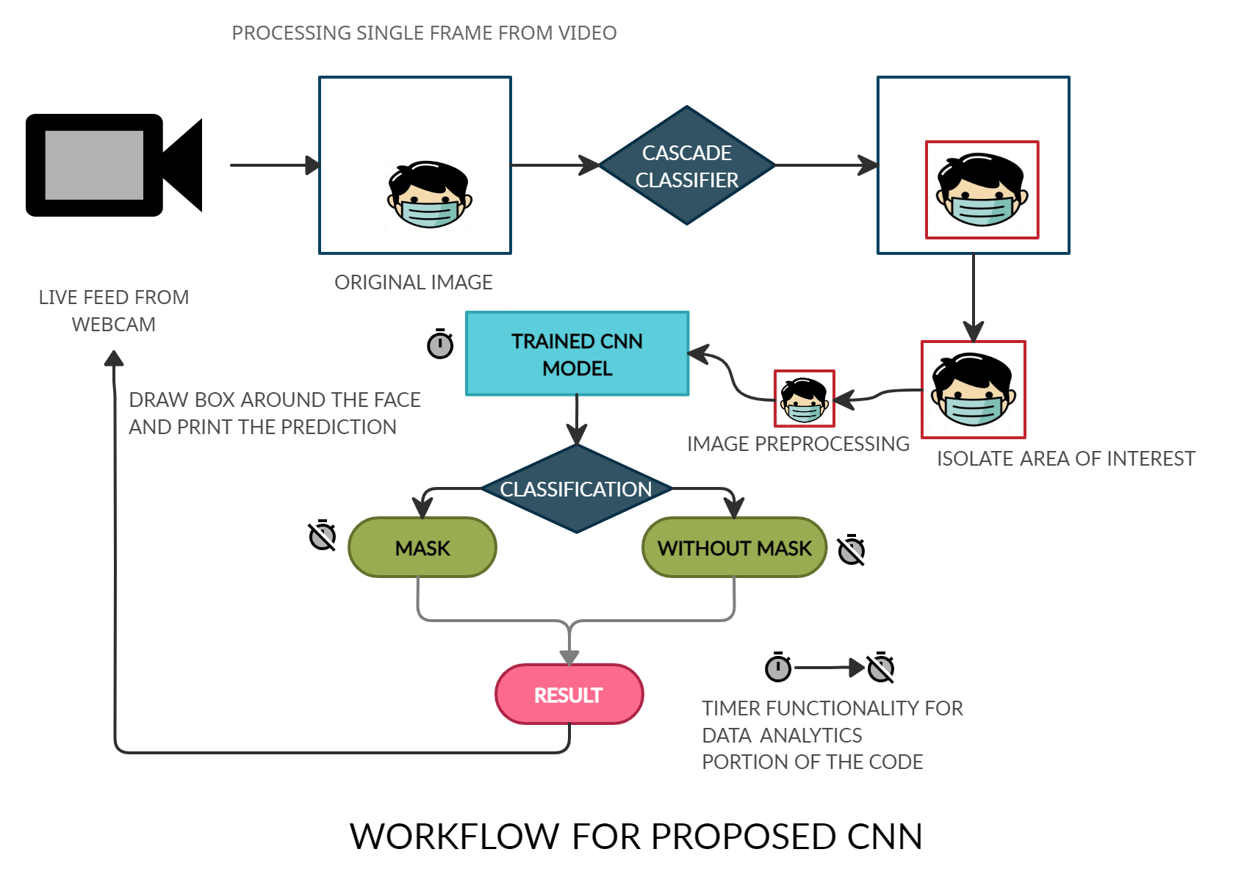
WORKFLOW DIAGRAM

Slide 11
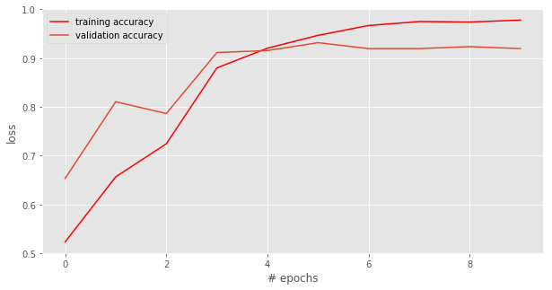
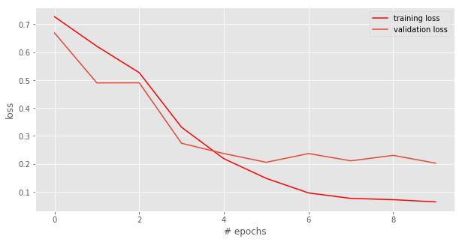
RESULTS OF CUSTOM CNN
Figure: plot of training accuracy and validation accuracy.
Figure: plot of training loss and validation loss.

Slide 12
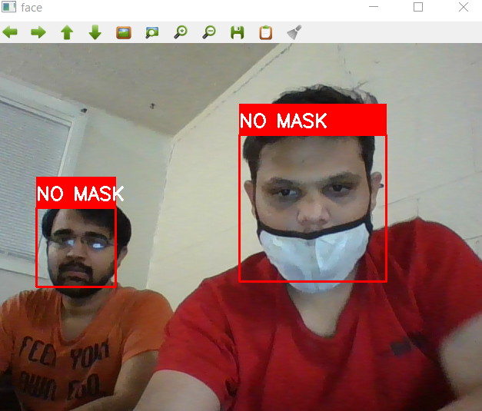
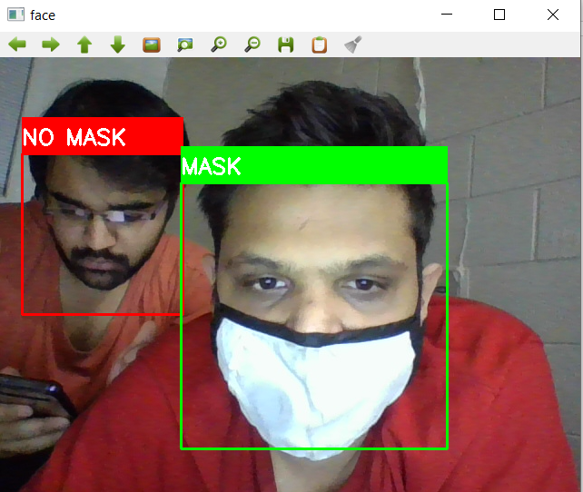
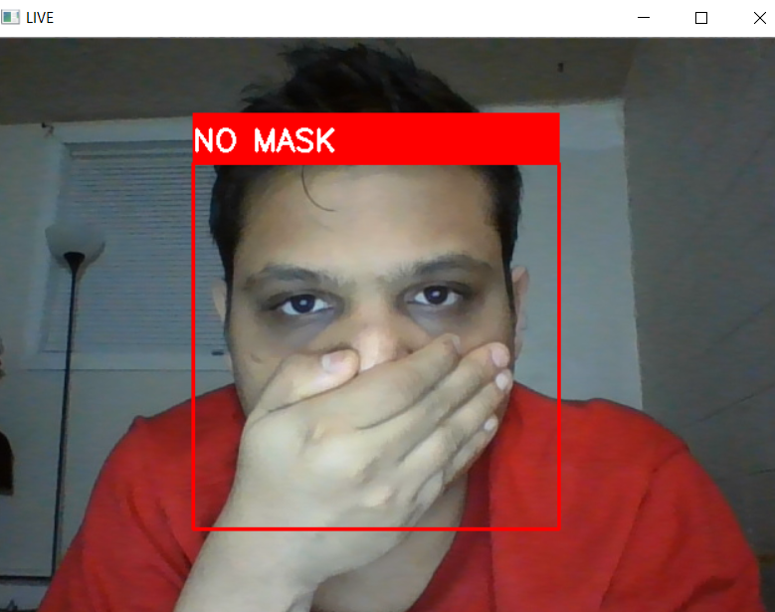
RESULTS OF CUSTOM CNN
SCENARIO 1:
one without mask and
other with partially covered mask.
SCENARIO 2:
one without mask looking into
mobile and other with mask
SCENARIO 3:
person was covering his
face using his hands

Slide 13
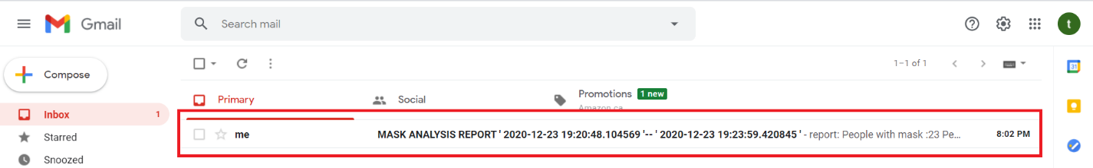
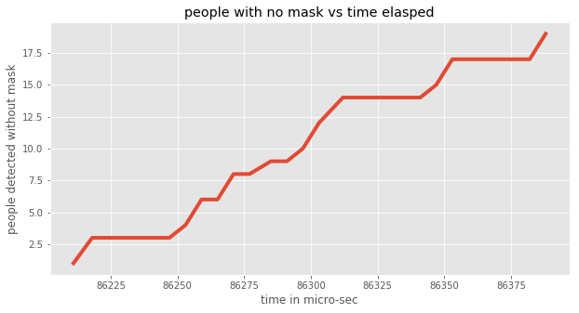
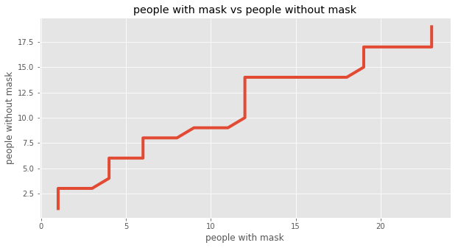
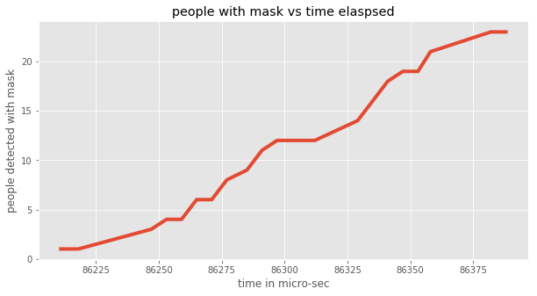
DATA ANALYTICS FROM PREDICTIONS
REPORT GENERATION AND REPORT IS MAILED TO THE SECURITY DESK

Slide 14
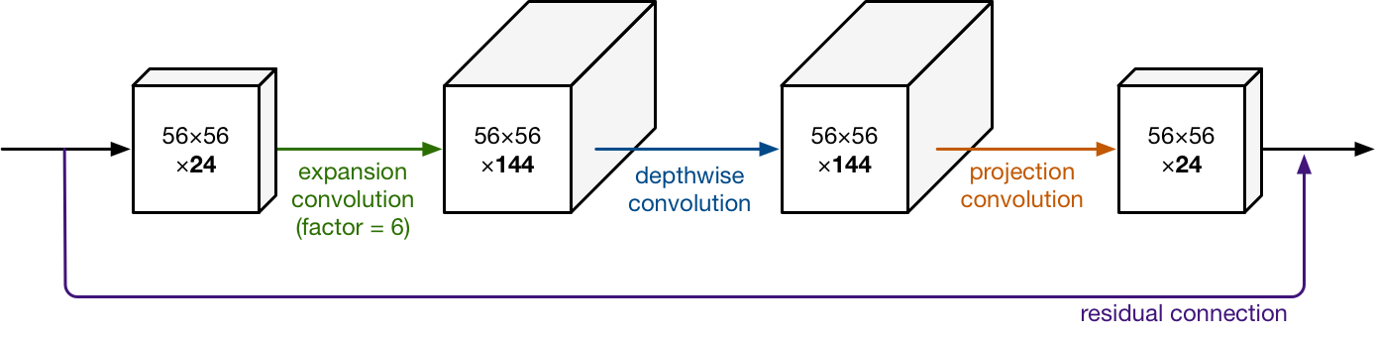
Benchmark method: MobilenetV2
This model was developed by the Google researchers and they had optimized this model for the mobile devices. This was computationally less expensive as it involved reduction in parameters and mathematical operations. This model - MobileNet uses depthwise separable convolutions, which comprises a depthwise and a pointwise convolution after one another.

Slide 15
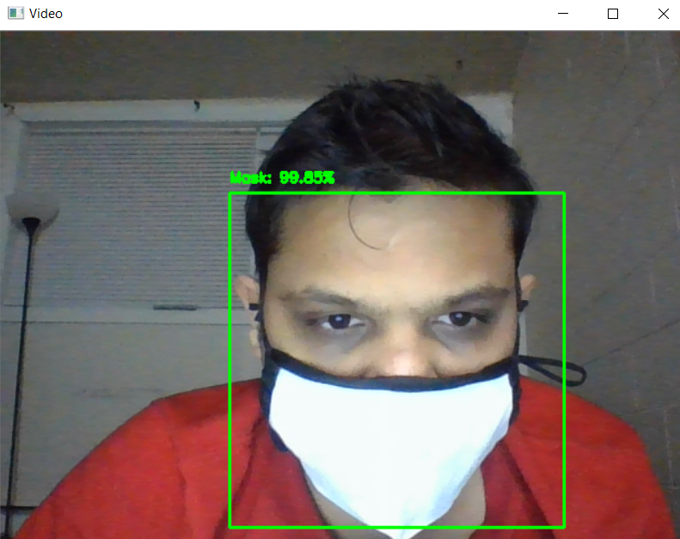
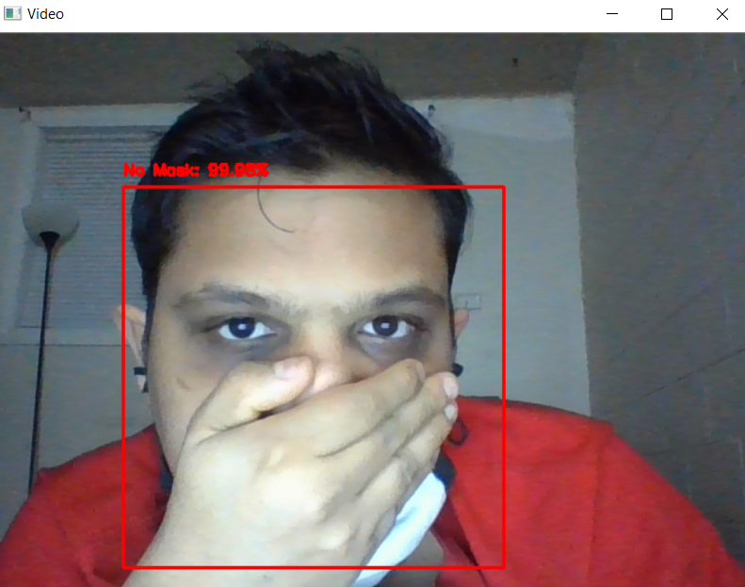
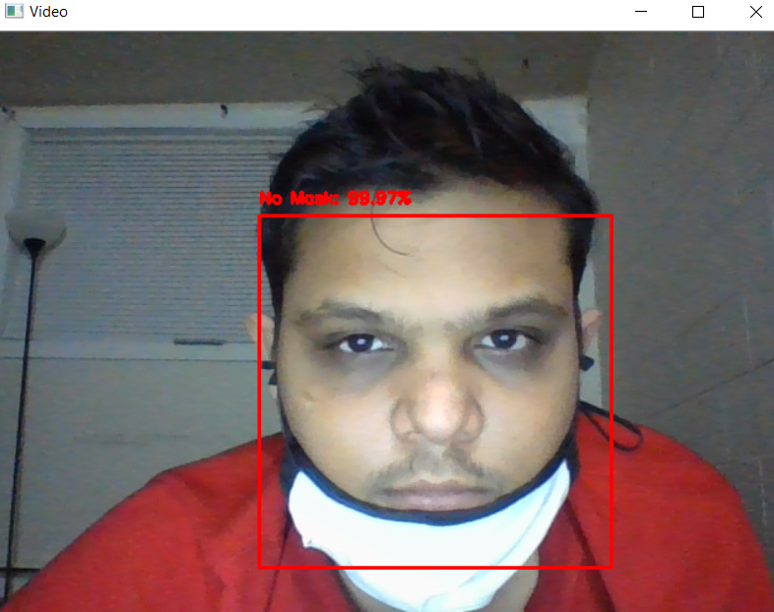
Results of benchmark method – MobilenetV2
SCENARIO 1:
partially covered mask.
SCENARIO 2:
PERSON WEARING THE MASK
SCENARIO 3:
person was covering his
face using his hands

Slide 16
Proposed neural network VS MobilenetV2
Sr. | Parameter | Proposed neural network | Benchmark – mobilenetv2
1 | Number of epochs | 10 | 10
2 | Average training time for each epoch | Approximately 43 seconds | Approximately 383 seconds
3 | Best training accuracy | 97.98% | 93.34%
4 | Result for fully covered condition | Detected the mask | Detected the mask
5 | Result for partially covered condition | Detected the no mask condition | Detected the no mask condition
6 | Result for face covered with hands | Detected the no mask condition | Detected the no mask condition

Slide 17
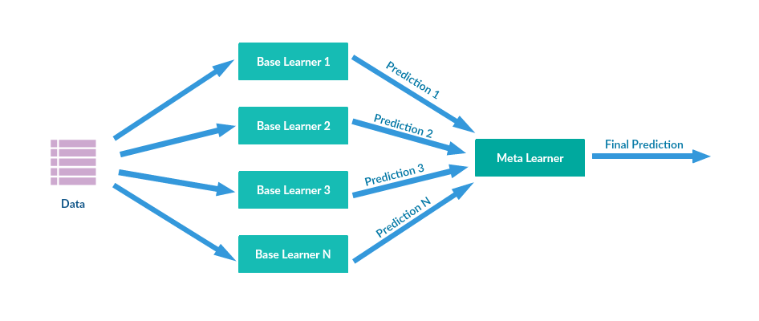
Future work
We would like to use stacking approach in machine learning for further developing our custom
model. Using our custom pretrained model with other model to detect if user has worn mask partially and which part of his face is exposed.

Slide 18
REFERENCES
"Convolutional Neural Networks." Convolutional Neural Networks, www.doc.ic.ac.uk/~jce317/introduction-cnns.html#top.
Phung, V.H.; Rhee, E.J. A Deep Learning Approach for Classification of Cloud Image Patches on Small Datasets. J. Inf. Commun. Converg. Eng. 2018, 16, 173–178, doi:10.6109/jicce.2018.16.3.173.
"Understanding of Convolutional Neural Network (CNN) — Deep Learning." Understanding of Convolutional Neural Network (CNN) — Deep Learning, medium.com/@RaghavPrabhu/understanding-of-convolutional-neural-network-cnn-deep-learning-99760835f148.
"Convolutional neural network." Convolutional neural network - Wikipedia, en.wikipedia.org/wiki/Convolutional_neural_network.
"Provincial and territorial resources for COVID-19." COVID-19: Non-medical masks and face coverings - Canada.ca, www.canada.ca/en/public-health/services/diseases/2019-novel-coronavirus-infection/symptoms/provincial-territorial-resources-covid-19.html.
Gurav, Omkar. "Face Mask Detection Dataset." Face Mask Detection Dataset | Kaggle, www.kaggle.com/omkargurav/face-mask-dataset.

Slide 19
THANK YOU
QUESTIONS ?

